Slide 1
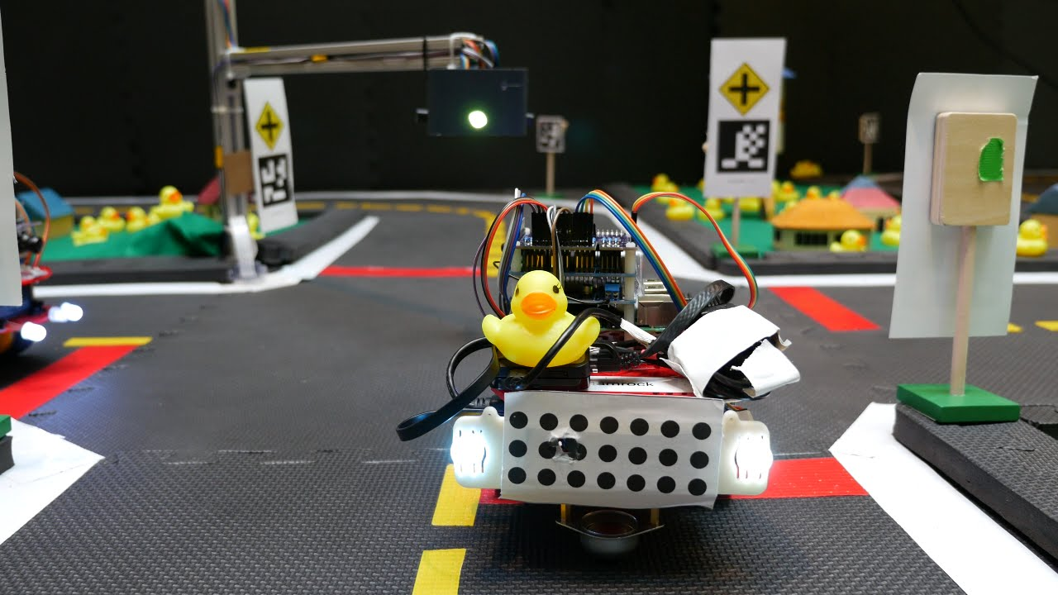
Duckie town
Represented by: Nada Samir – Ahmed Sayed – Ahmed Ahmed – Adham Sakr – Adam Shawky – Amr Ashraf – Eslam Arafa – Ahmed Nasser – Nour Morsy

Slide 2

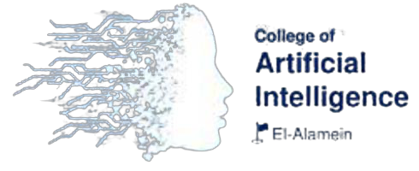
Agenda
About the competition
Objective and Application
Lane Following
Reinforcement Learning in ROS
Algorithm Overview
Depth Algorithm

Slide 3
About the competition
Duckietown started as a class at MIT in 2016.
Duckietown is now a worldwide initiative to realize a new vision for AI and robotics education: state-of-the-art, hands-on, and for all.
Since 2018 the project is coordinated by the non-profit Duckietown Foundation
It has been used in prestigious universities, such as MIT, ETH Zürich, Université de Montréal, and many more.

Slide 4
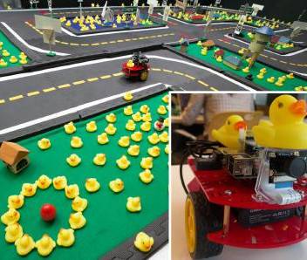
About the competition
Duckietown has many components that work together to provide a joyful learning experience. The most tangible is the hardware:
DuckieBots
DuckieTowns.
DuckieBots are low-cost mobile robots that are built almost entirely from off-the-shelf parts.
DuckieTowns are the urban environments: roads, constructed from exercise mats and tape, and the signage which the robots use to navigate around.
DuckieTowns can be transformed into smart cities (“Autolabs”) by adding traffic lights and watchtowers.

Slide 5
Objective and Application
Self-driving vehicles are poised to become one of the most pervasive and impactful applications of autonomy.
Designing a Self-driving car is complex because of the different components and how complex it is and here it comes duckie town.
The duckie town brings up theses problem with in simple form to design and implement it with minimal cost in the car (i.e. duckie bot).
Duckie town addressing some problems for example:
Lane following
Navigation
Multirobot behaviours
They provide many frame works to build the design architecture for example: ROS

Slide 6
Lane following
The most basic task of the Duckiebot is lane following.
This task is implemented using a realistic computer vision pipeline that contains these steps:
Capture image
Filter noise (Threshold/Masking)
Detect line lanes
Then, lane centroid is calculated, and error is deduced.

Slide 7
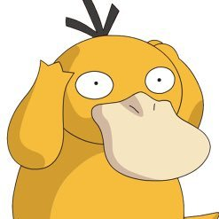
So how will the duck learn ?

Slide 8
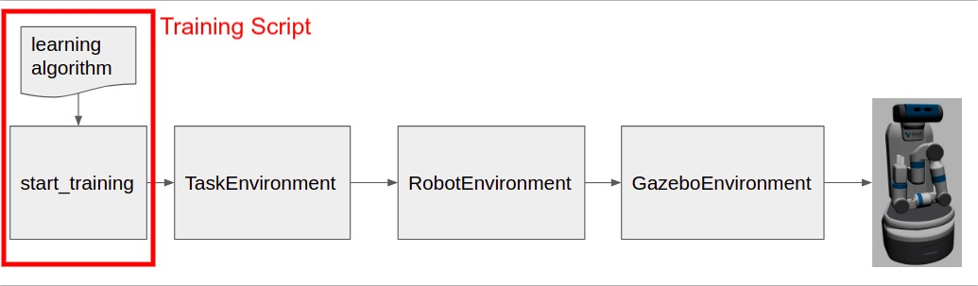
Reinforcment learning with ros
We need to solve this problem by using reinforcement learning.
OpenAI ROS provide a way to build a reinforcment learning algorithm by using ROS to control the agent(i.e car)
To make the agent train by itself we will build some parts:
Gazebo environment
Robot environment
Task environment
learning algorithm(i.e. training script)

Slide 9
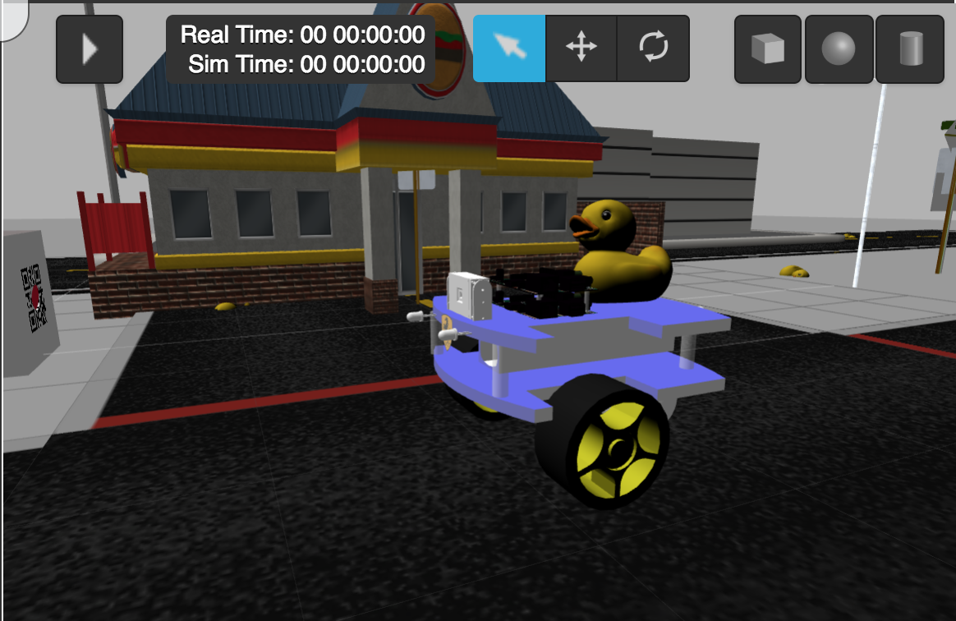
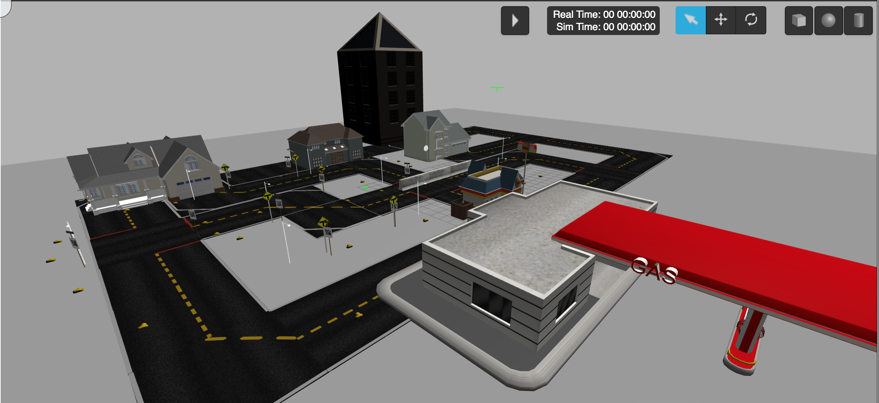
Gazebo environment
To make the robot learn using RL we need to build an enviroment for it (i.e simulation), therefore we used gazebo simulator for.
To build an enviroment we need two components:
Word file -> to define simulation and it’s models(i.e streets , traffics,etc).
URDF file -> to define the robot components (i.e motors , camera,etc).

Slide 10
Robot environment
The robot environment will then contain all the functions associated to the specific robot that you want to train in our case duckiebot. This means, it will contain all the ROS functionalities that your robot will need in order to be controlled.
Therefore we will build a class contain some points:
How our robot works.
How to access our robot's sensor(s).
Which topic(s) does our robot respond to (i.e camera , motors).
Learning algorithm is necessary for the robot environment to learn from it.

Slide 11
Robot Environment
class DuckieTownEnv(robot_gazebo_env.RobotGazeboEnv):
def __init__(self):
pass
def _check_all_systems_ready(self):
pass
def _check_all_sensors_ready(self):
pass
def _check_odom_ready(self):
pass
def _check_camera_rgb_image_raw_ready(self):
pass
def _odom_callback(self, data):
pass
def _camera_rgb_image_raw_callback(self, data):
pass
def _camera2_rgb_image_raw_callback(self, data):
pass
def _check_publishers_connection(self):
pass
def _set_init_pose(self):
pass
def _init_env_variables(self):
pass
def _compute_reward(self, observations, done):*
pass
def _set_action(self, action):*
pass
def _get_obs(self):*
pass
def _is_done(self, observations):
pass
def move_base(self, linear_speed, angular_speed, epsilon=0.05, update_rate=10, use_offset=True):
pass
def get_odom(self):
pass
def get_camera_rgb_image_raw(self):
pass
def get_camera2_rgb_image_raw(self):
pass

Slide 12
Task Environment
The task environment class provides all the context for the task we want the robot to learn.
Task Environment specifies the following required for the training:
function _init_env_variables: used to initialise any var that need to be set back to initial value on every episode.
function _set_init_pose: used to initialise the robot position on every episode.
How to apply the selected action to the robot: function _set_action
In this function the robot can take three actions:
Turn left
Turn right
Forward
How to get the observations resulting from the action: function _get_obs
In our case the robot will observe the images from the camera.
How to compute the reward: function _compute_reward
Our reward system will be based on how far or near the robot’s front body with respect to the lane (e.g (centered) = 100 and (off-course) = -10).
Detect if the training for the current episode is finished: function _is_done

Slide 13
Task environment
def _set_action(self, action):
"""
This set action will Set the linear and angular speed of the DuckBot
based on the action number given.
:param action: The action integer that set s what movement to do next.
"""
rospy.logdebug("Start Set Action ==>"+str(action))
self.action_taken = action
# We convert the actions to speed movements to send to the parent class CubeSingleDiskEnv
if action == 0: #FORWARD
linear_speed = self.linear_forward_speed
angular_speed = 0.0
self.last_action = "FORWARD"
elif action == 1: #LEFT
linear_speed = self.linear_turn_speed
angular_speed = self.angular_speed
self.last_action = "TURN_LEFT"
elif action == 2: #RIGHT
linear_speed = self.linear_turn_speed
angular_speed = -1*self.angular_speed
self.last_action = "TURN_RIGHT"
# We tell DuckBot the linear and angular speed to set to execute
self.move_base( linear_speed,
angular_speed,
epsilon=0.05,
update_rate=10)
rospy.logdebug("END Set Action ==>"+str(action))

Slide 14
Task environment
def _compute_reward(self, observations, done):
"""
Our reward system will be based on how far or near the robot's forward with respect to the lane
E.g 0(centered) = 100 and 1(off-course) = -10
"""
if not done:
if (self.action_taken != None):
if(self.action_taken == 0):
reward = self.follow_lane_reward #Favour going foward to turning left/right
else:
reward = self.left_right_reward
else:
reward = -1*self.follow_lane_reward
rospy.logdebug("reward=" + str(reward))
self.cumulated_reward += reward
rospy.logdebug("Cumulated_reward=" + str(self.cumulated_reward))
self.cumulated_steps += 1
rospy.logdebug("Cumulated_steps=" + str(self.cumulated_steps))
return reward
def _is_done(self, observations):
if self._episode_done:
rospy.logerr("DuckBot veered OFF-COURSE ==>")
return self._episode_done
else:
rospy.logerr("DuckBot is Ok ==>")
return self._episode_done

Slide 15
Task environment
def _set_init_pose(self):
"""Sets the Robot in its init pose
"""
self.line_follow.clean_up()
self.move_base( self.init_linear_forward_speed,
self.init_linear_turn_speed,
epsilon=0.05,
update_rate=10,
use_offset=False) #Do not check for lane
return True
def _init_env_variables(self):
"""
Inits variables needed to be initialised each time we reset at the start
of an episode.
:return:
"""
# For Info Purposes
self.cumulated_reward = 0.0
# Set to false Done, because its calculated asyncronously
self._episode_done = False
# We wait a small ammount of time to start everything because in very fast resets, laser scan values are sluggish
# and sometimes still have values from the prior position that triguered the done.
time.sleep(0.2)

Slide 16
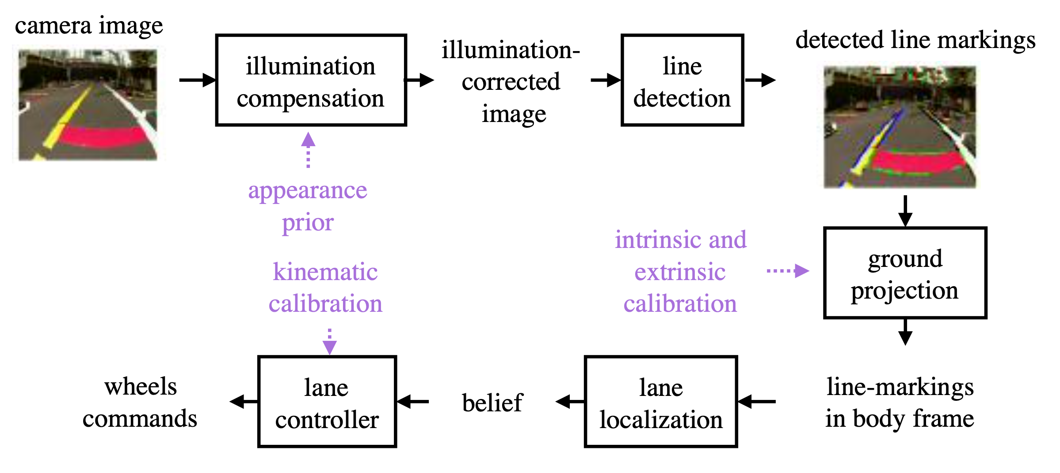
Learning Algorithm
After building the enviroment and robot enviroment we need to build the learning algorithm:
Algorithm for the lane detection.
Reinforcment learning algorithm .

Slide 17
Lane Detection
The algorithm for lane detection:
Take observation from the camera.
Calculate the centroid of the lane.
Calculate the error between the car and lane.
Calculate kinematics equations and speed depending on error.
Send coordinates to motors.

Slide 18
Lane Detection
class LineFollower(object):
def __init__(self):
self.bridge_object = CvBridge()
# Convert to numpy array and return converted data
def convert_image(self, data):
im = np.frombuffer(data.data, dtype=np.uint8).reshape(data.width, data.height, -1)
return im
def process_data(self,observation_image, detection_image, rows_to_watch ,show_window=False):
recalculate = False
try:
# We select bgr8 because its the OpneCV encoding by default
cv_image = self.bridge_object.imgmsg_to_cv2(detection_image, desired_encoding="bgr8")
except CvBridgeError as e:
print(e)
# We get image dimensions and crop the parts of the image we don't need
# Bear in mind that because the first value of the image matrix is start and second value is down limit.
# Select the limits so that it gets the line not too close and not too far, and the minimum portion possible
# To make process faster.
height, width, channels = cv_image.shape
top_trunc = 1*height / 2 #get 1/2 of the height from the top section of the image
bottom_trunc = top_trunc + rows_to_watch #next set of rows to be used
crop_img = cv_image[top_trunc:bottom_trunc, 0:width]
# Convert from RGB to HSV
hsv = cv2.cvtColor(crop_img, cv2.COLOR_BGR2HSV).astype(np.float)
# Define the Yellow Colour in HSV
#RGB
#[[[222,255,0]]]
#BGR
#[[[0,255,222]]]

Slide 19
Lane Detection
"""
To know which color to track in HSV, Put in BGR. Use ColorZilla to get the color registered by the camera
>>> yellow = np.uint8([[[B,G,R ]]])
>>> hsv_yellow = cv2.cvtColor(yellow,cv2.COLOR_BGR2HSV)
>>> print( hsv_yellow )
[[[ 34 255 255]]
"""
lower_yellow = np.array([20,100,100])
upper_yellow = np.array([50,255,255])
# Threshold the HSV image to get only yellow colors
mask = cv2.inRange(hsv, lower_yellow, upper_yellow)
# Calculate centroid of the blob of binary image using ImageMoments
m = cv2.moments(mask, False)
try:
cx, cy = m['m10']/m['m00'], m['m01']/m['m00']
except ZeroDivisionError:
cy, cx = height/2, width/2
recalculate = True
if(show_window):
# Bitwise-AND mask and original image
res = cv2.bitwise_and(crop_img,crop_img, mask= mask)
# Draw the centroid in the resultut image
# cv2.circle(img, center, radius, color[, thickness[, lineType[, shift]]])
cv2.circle(res,(int(cx), int(cy)), 10,(0,0,255),-1)
cv2.imshow("Original", cv_image)
cv2.imshow("HSV", hsv)
cv2.imshow("MASK", mask)
cv2.imshow("RES", res)
cv2.waitKey(1)
error_x = cx - width / 2;
angular_z = -error_x / 100;
rospy.loginfo("ANGULAR VALUE SET===>"+str(angular_z))
return (recalculate, angular_z, self.convert_image(observation_image))
def clean_up(self):
cv2.destroyAllWindows()

Slide 20
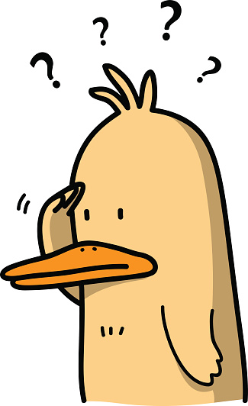
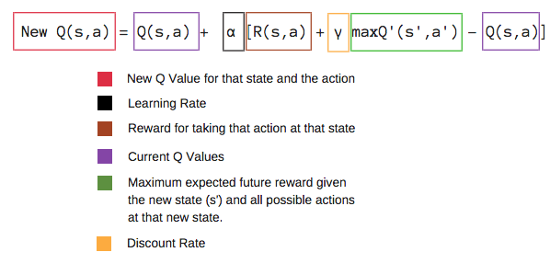
Reinforcment Learning Algorithm
To build the reinforcment learning to make the robot learn we need to define a few things:
The reinforcment learning algorithm (i.e Qlearn , MDP) in our case we will use Qlearning
The parameters that define the algorithm (i.e alpha , reward , action , decay , etc).
After that we will integrate all the componts in a starting script.

Slide 21
Reinforcment learning algorithm
We will define the Qlearn prameters
alpha: 1.0
gamma: 0.7
epsilon: 0.9
epsilon_discount: 0.999
nepisodes: 500
nsteps: 500
number_splits: 10 #set to change the number of state splits for the continuous problem and also the number of env_variable splits

Slide 22
Reinforcement Learning Algorithm
We will build the Qlearn algorithm
lass QLearn:
def __init__(self, actions, epsilon, alpha, gamma):
self.q = {}
self.epsilon = epsilon # exploration constant
self.alpha = alpha # discount constant
self.gamma = gamma # discount factor
self.actions = actions
def getQ(self, state, action):
return self.q.get((state, action), 0.0)
def learnQ(self, state, action, reward, value):
'''
Q-learning:
Q(s, a) += alpha * (reward(s,a) + max(Q(s') - Q(s,a))
'''
oldv = self.q.get((state, action), None)
if oldv is None:
self.q[(state, action)] = reward
else:
self.q[(state, action)] = oldv + self.alpha * (value - oldv)
def chooseAction(self, state, return_q=False):
q = [self.getQ(state, a) for a in self.actions]
maxQ = max(q)

Slide 23
Reinforcement Learning Algorithm
if random.random() < self.epsilon:
minQ = min(q); mag = max(abs(minQ), abs(maxQ))
# add random values to all the actions, recalculate maxQ
q = [q[i] + random.random() * mag - .5 * mag for i in range(len(self.actions))]
maxQ = max(q)
count = q.count(maxQ)
# In case there're several state-action max values
# we select a random one among them
if count > 1:
best = [i for i in range(len(self.actions)) if q[i] == maxQ]
i = random.choice(best)
else:
i = q.index(maxQ)
action = self.actions[i]
if return_q: # if they want it, give it!
return action, q
return action
def learn(self, state1, action1, reward, state2):
maxqnew = max([self.getQ(state2, a) for a in self.actions])
self.learnQ(state1, action1, reward, reward + self.gamma*maxqnew)

Slide 24
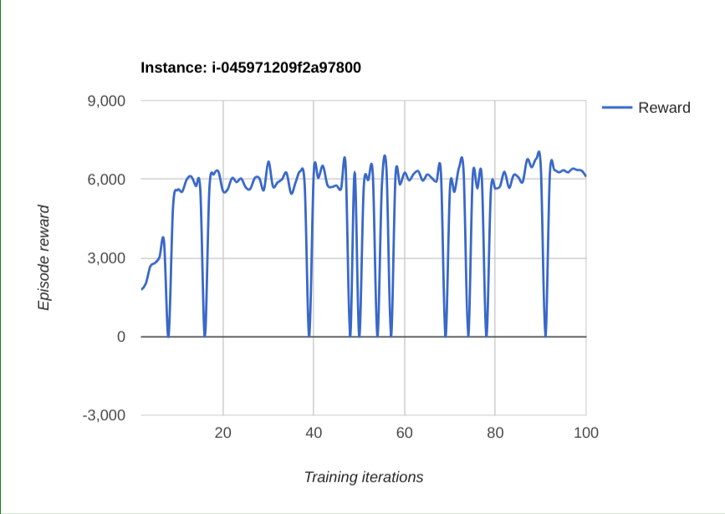
Reward Chart

Slide 25
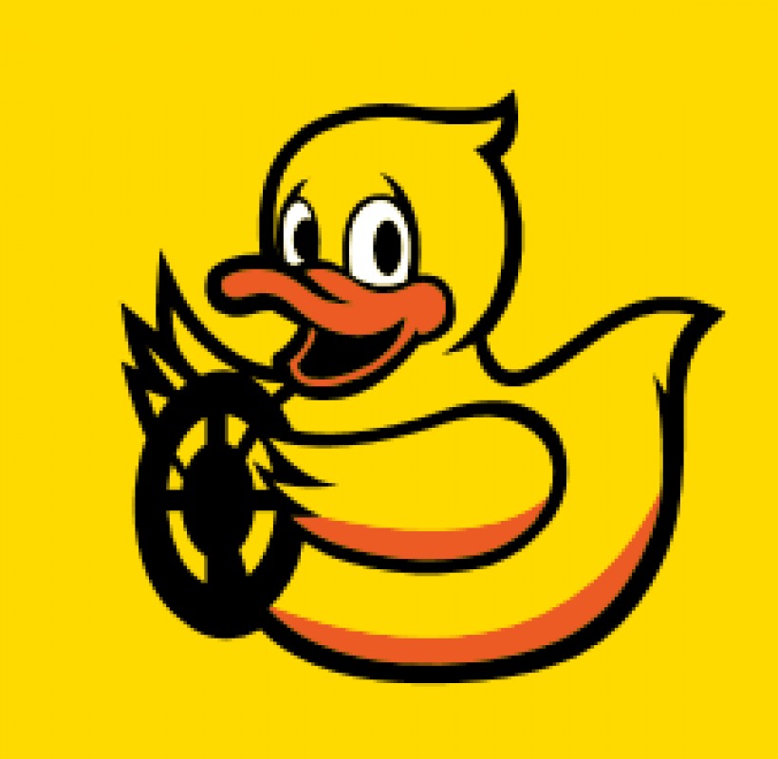
Thank you

